Slide 1
Cryogenic Material Library – An Overview
Henry Nachman
28 August 2024
CMB-S4 Technical Meeting

Slide 2
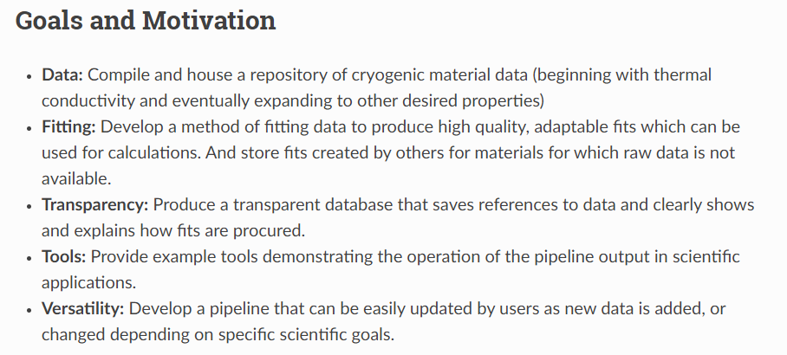

Slide 3
What does this repo have?

Slide 4
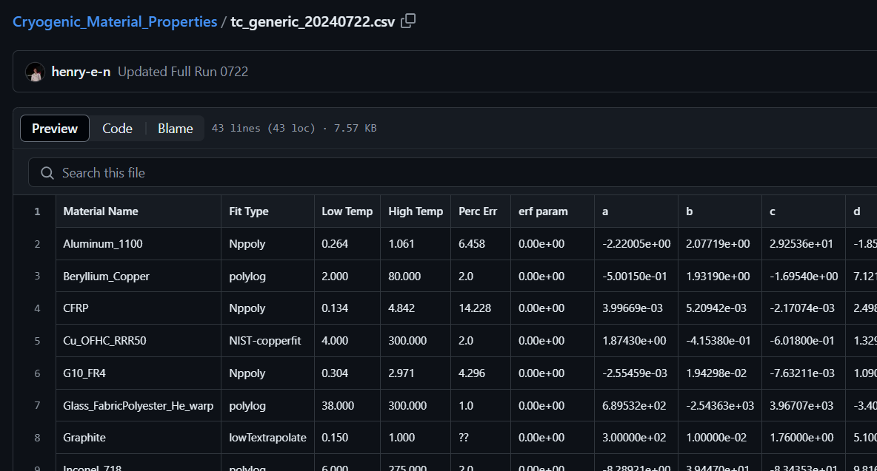
Material Name
Fit Parameters
(between 3 and 10+)
Range of Fit
Fit Type Flag

Slide 5
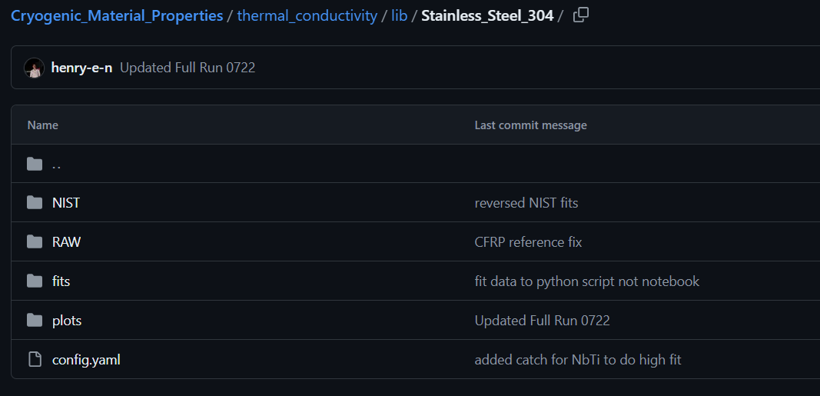
Fit pulled from NIST website
Raw thermal conductivity data (if available)
In-house fits (from raw data)
A config file with some necessary info like ‘parent’ materials, and data flags.

Slide 6
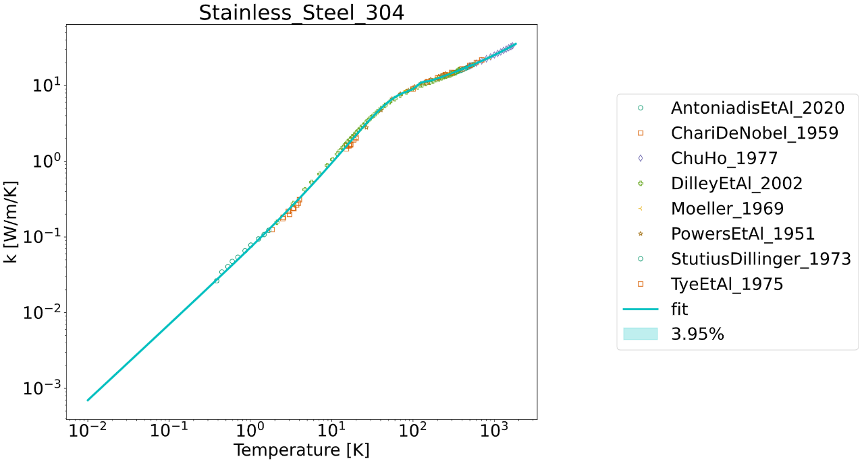

Slide 7
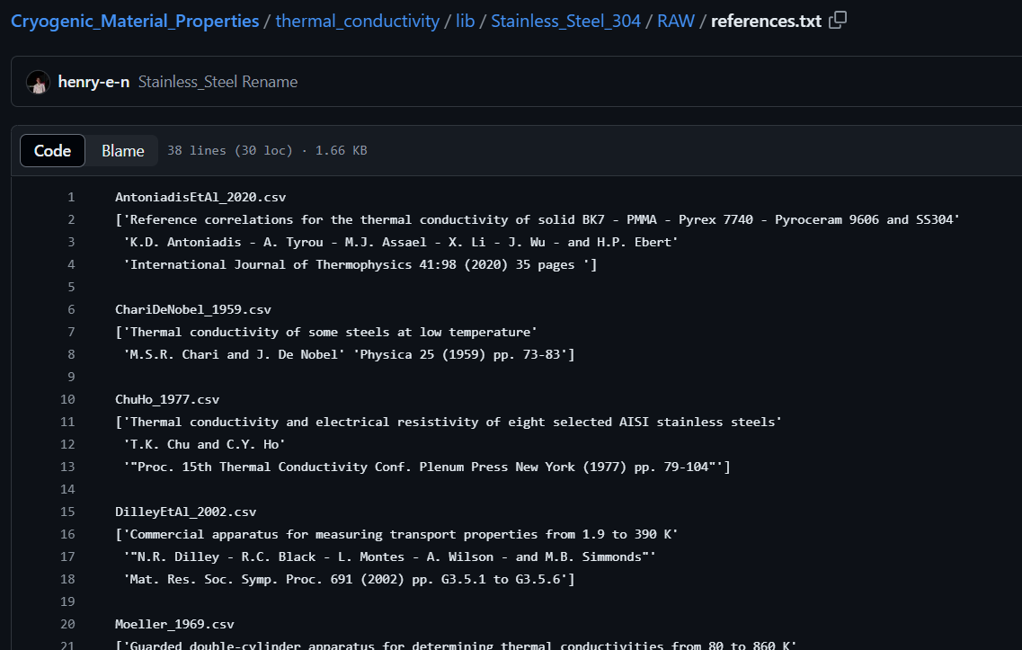

Slide 8
How can you use this repository?

Slide 9
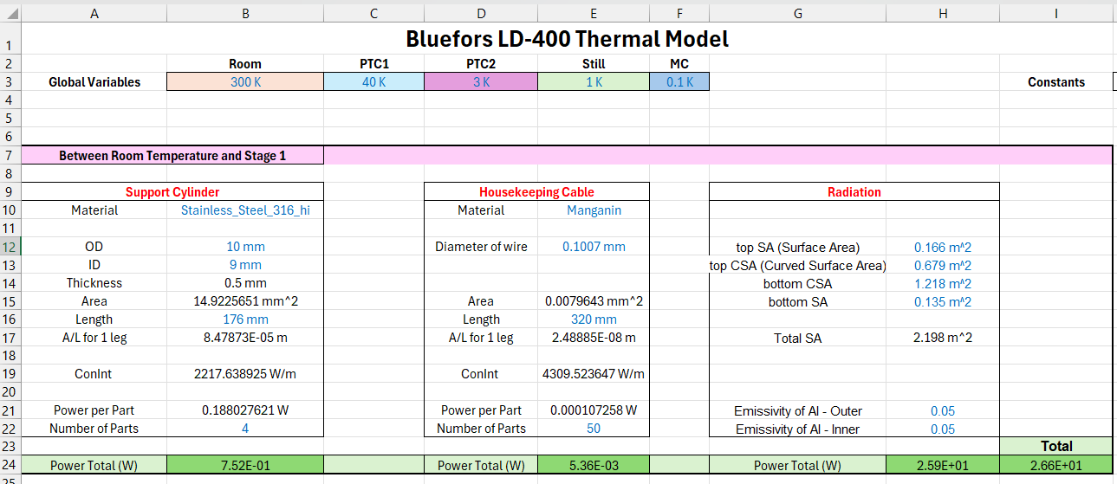

Slide 10
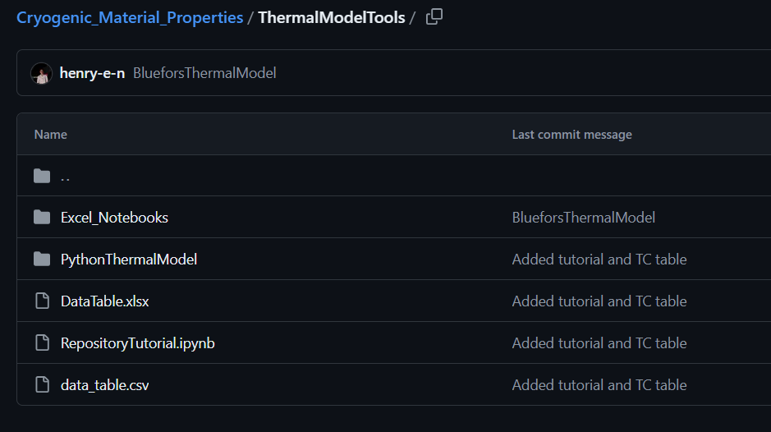
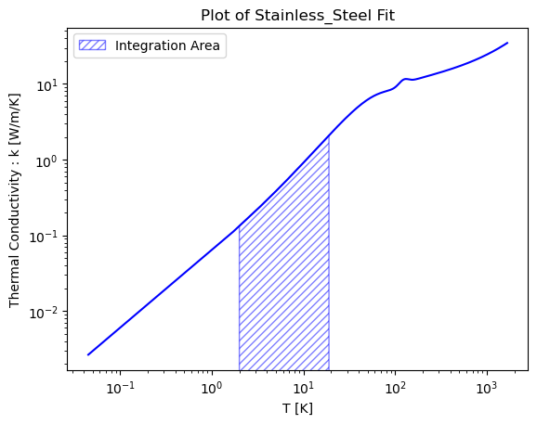
Old Fashioned Data Table
Tutorial Jupyter Notebook

Slide 11
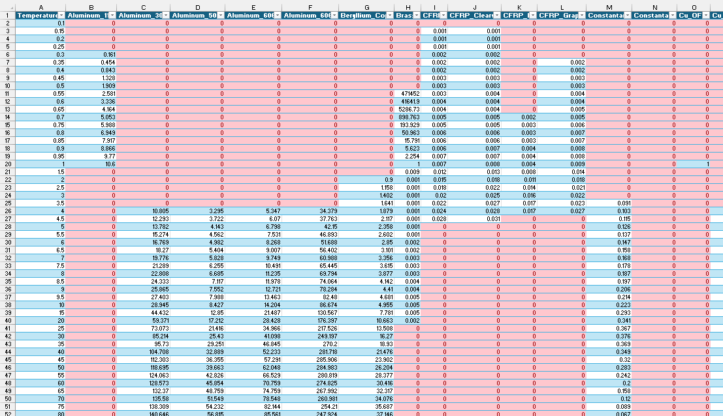
Notice all the red: Red means the repository is missing data (or has insufficient data) within that temperature range.

Slide 12
Next Steps
More data – fill in some of the gaps in data by tracking down other references and taking additional data (UT currently taking CFRP data). Perhaps even eventually add other properties.
More tools – long-term goals may include connecting the code to existing load calculators and more
Feedback – we need people to use the repository and give feedback on what works and what they would like changed or added.
Collaborative developers – we would be more than happy to work with others to further develop this repository so please get in contact if you (or a student) are interested in

Slide 13
Summary
Current development includes thermal conductivity fits, raw data, plots, and basic thermal model tools and examples.
Looking for more thermal conductivity data and feedback on existing repository features.
For code related problems/requests use the GitHub Issues tab.
Contact: Henry Nachman: henry.nachman@utexas.edu

